Slide 1
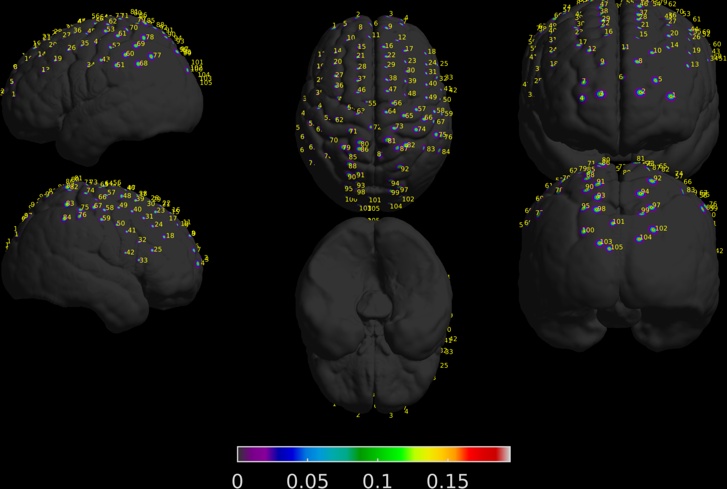
Progress on Haskin’s FNIRS data
Seok was able to project the coordinates on MNI brain
105 channels
Subject 1

Slide 2
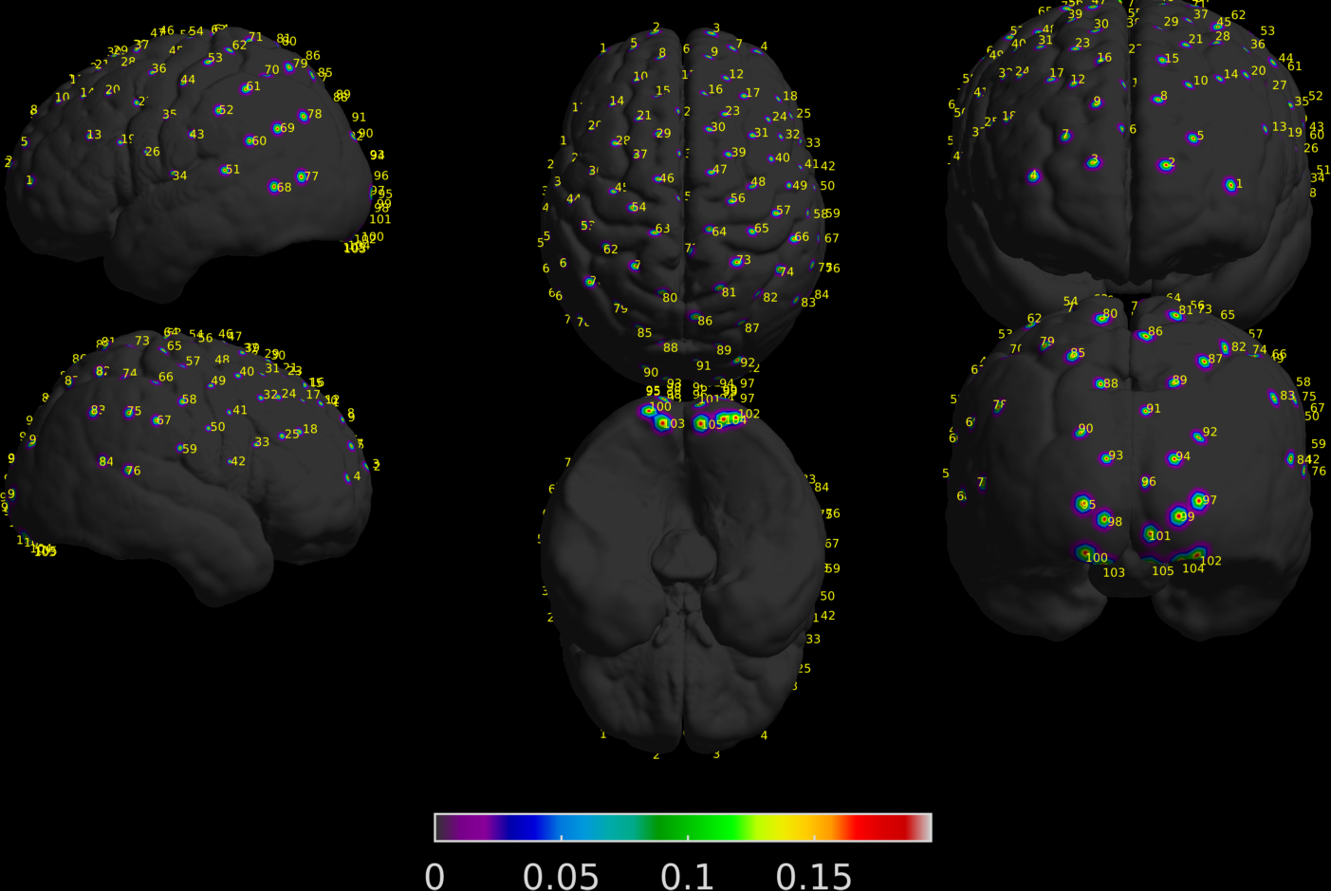
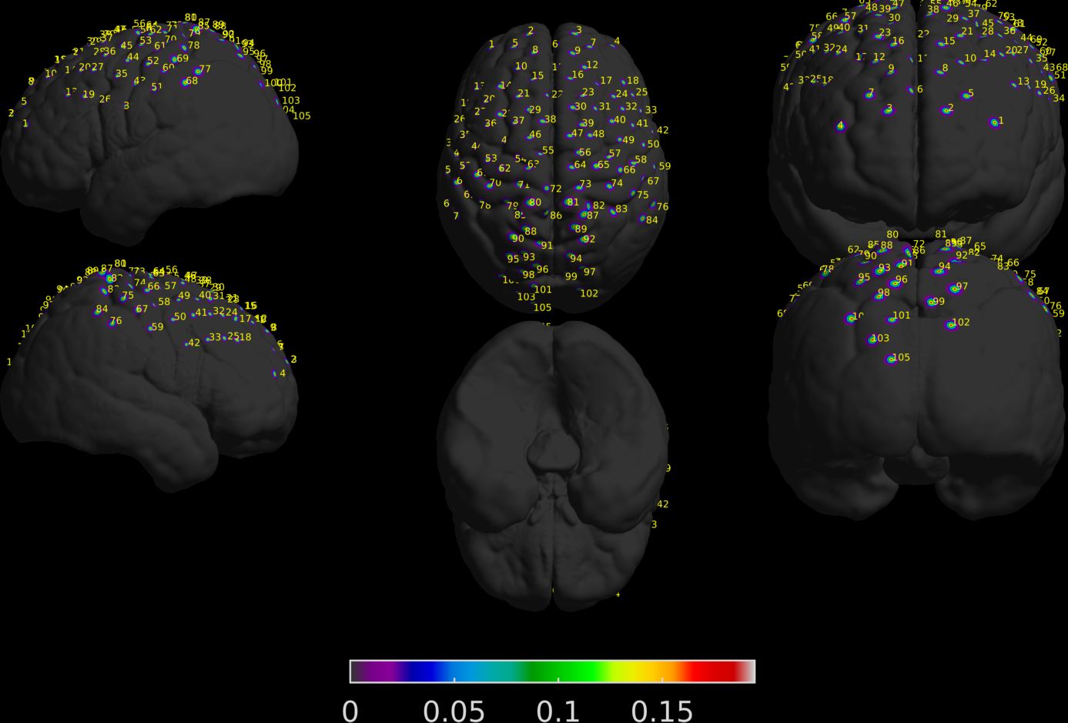
Progress on Haskin’s FNIRS data
Seok was able to project the coordinates on MNI brain
105 channels
Subject 28
Subject 29

Slide 3
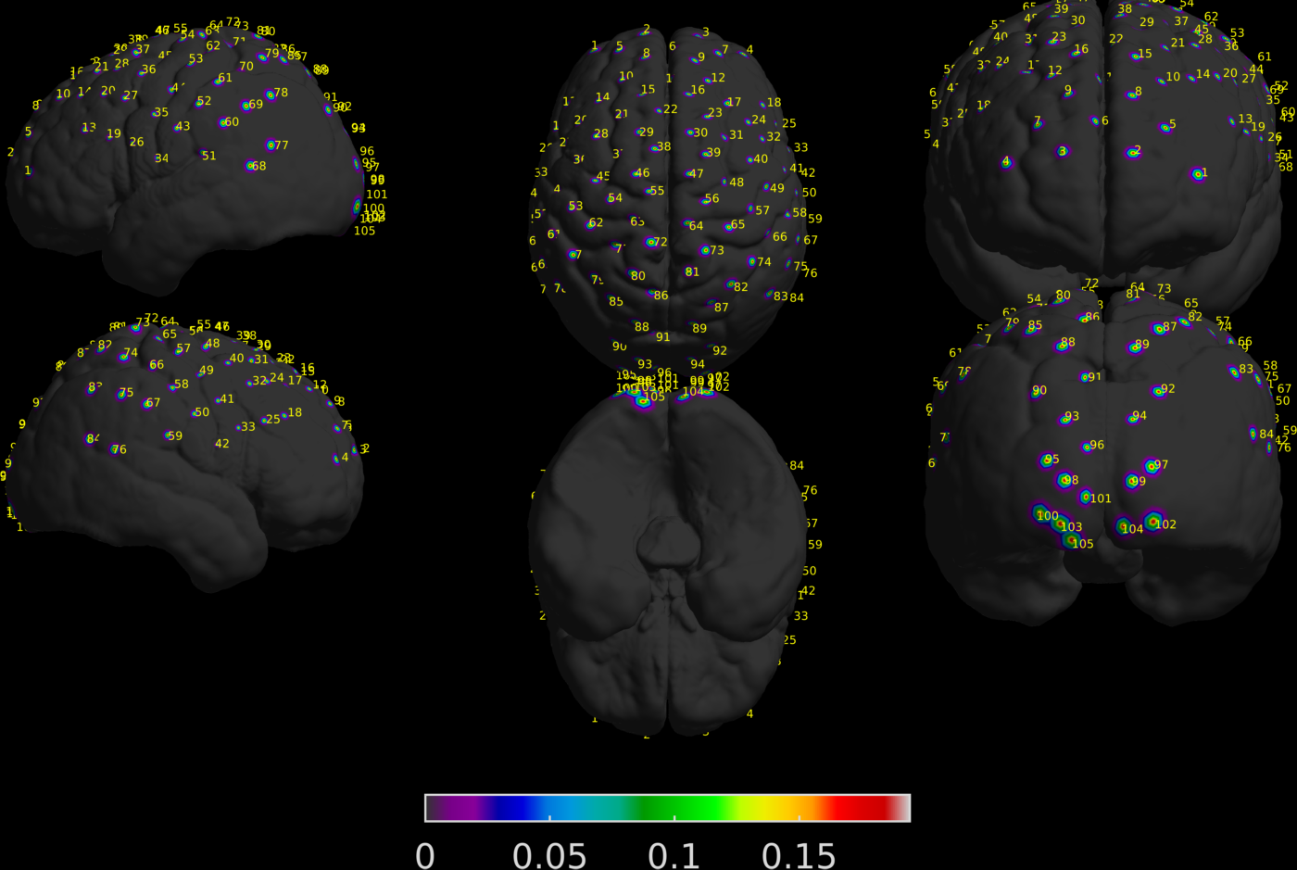
Progress on Haskin’s FNIRS data
Seok was able to project the coordinates on MNI brain
135 channels
Looks like there is only 105 channels
Subject 9

Slide 4
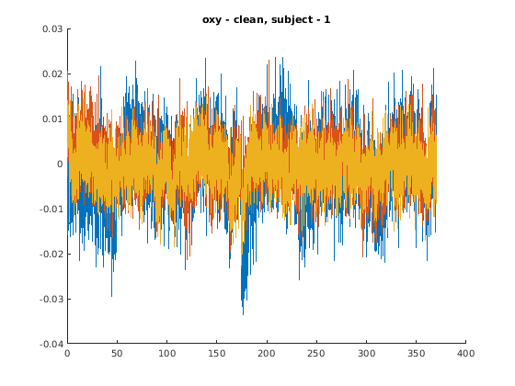
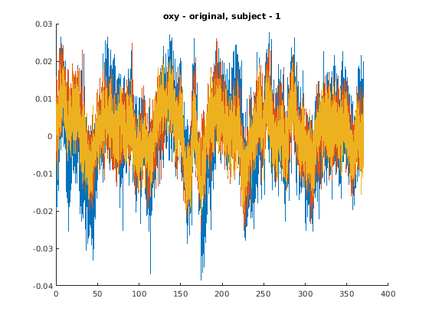
Raw data
105
Subject 1
OXY
Clean data
NOT clean data
Channels 1, 20, 90
Sampling rate – 10.10Hz

Slide 5
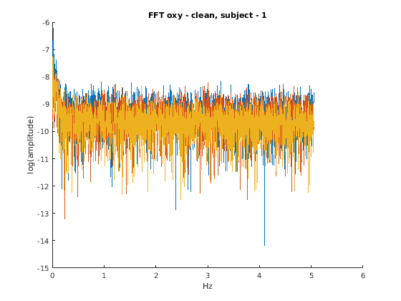
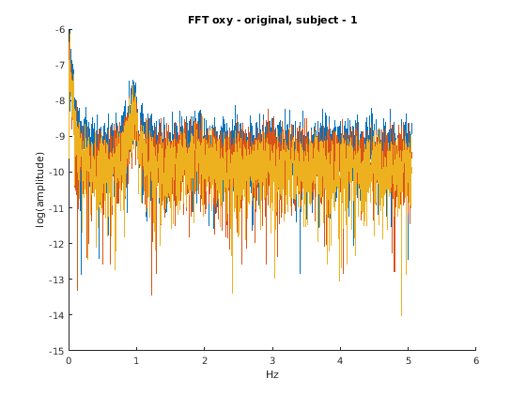
Raw data
105
Subject 1
OXY
Clean data
NOT clean data
Channels 1, 20, 90
Sampling rate – 10.10Hz

Slide 6
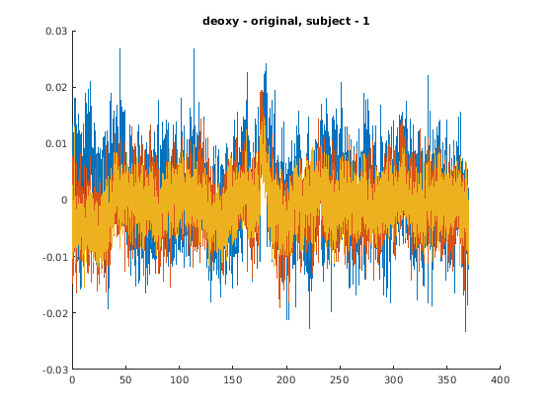
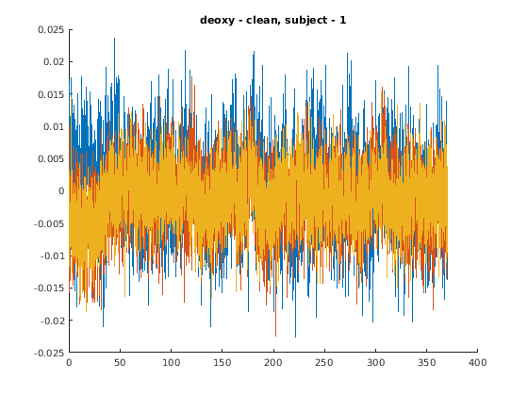
Raw data
105
Subject 1
DEOXY
Clean data
NOT clean data
Channels 1, 20, 90
Sampling rate – 10.10Hz

Slide 7
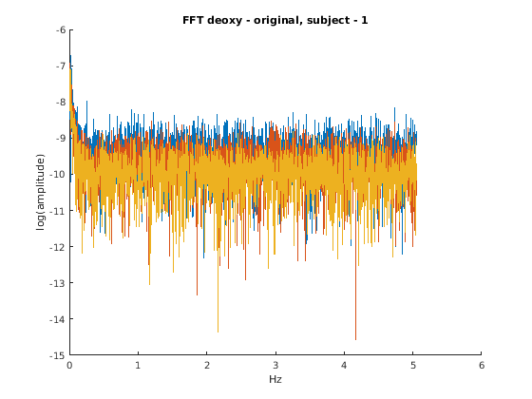
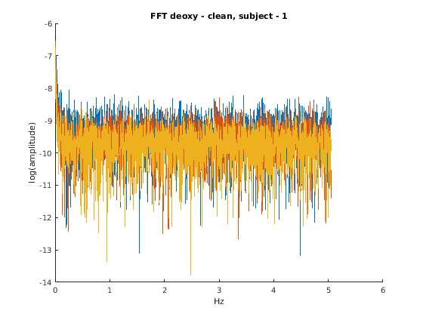
Raw data
105
Subject 1
DEOXY
Clean data
NOT clean data
Channels 1, 20, 90
Sampling rate – 10.10Hz

Slide 8
Wang 2017

Slide 10
Wang 2017

Slide 11
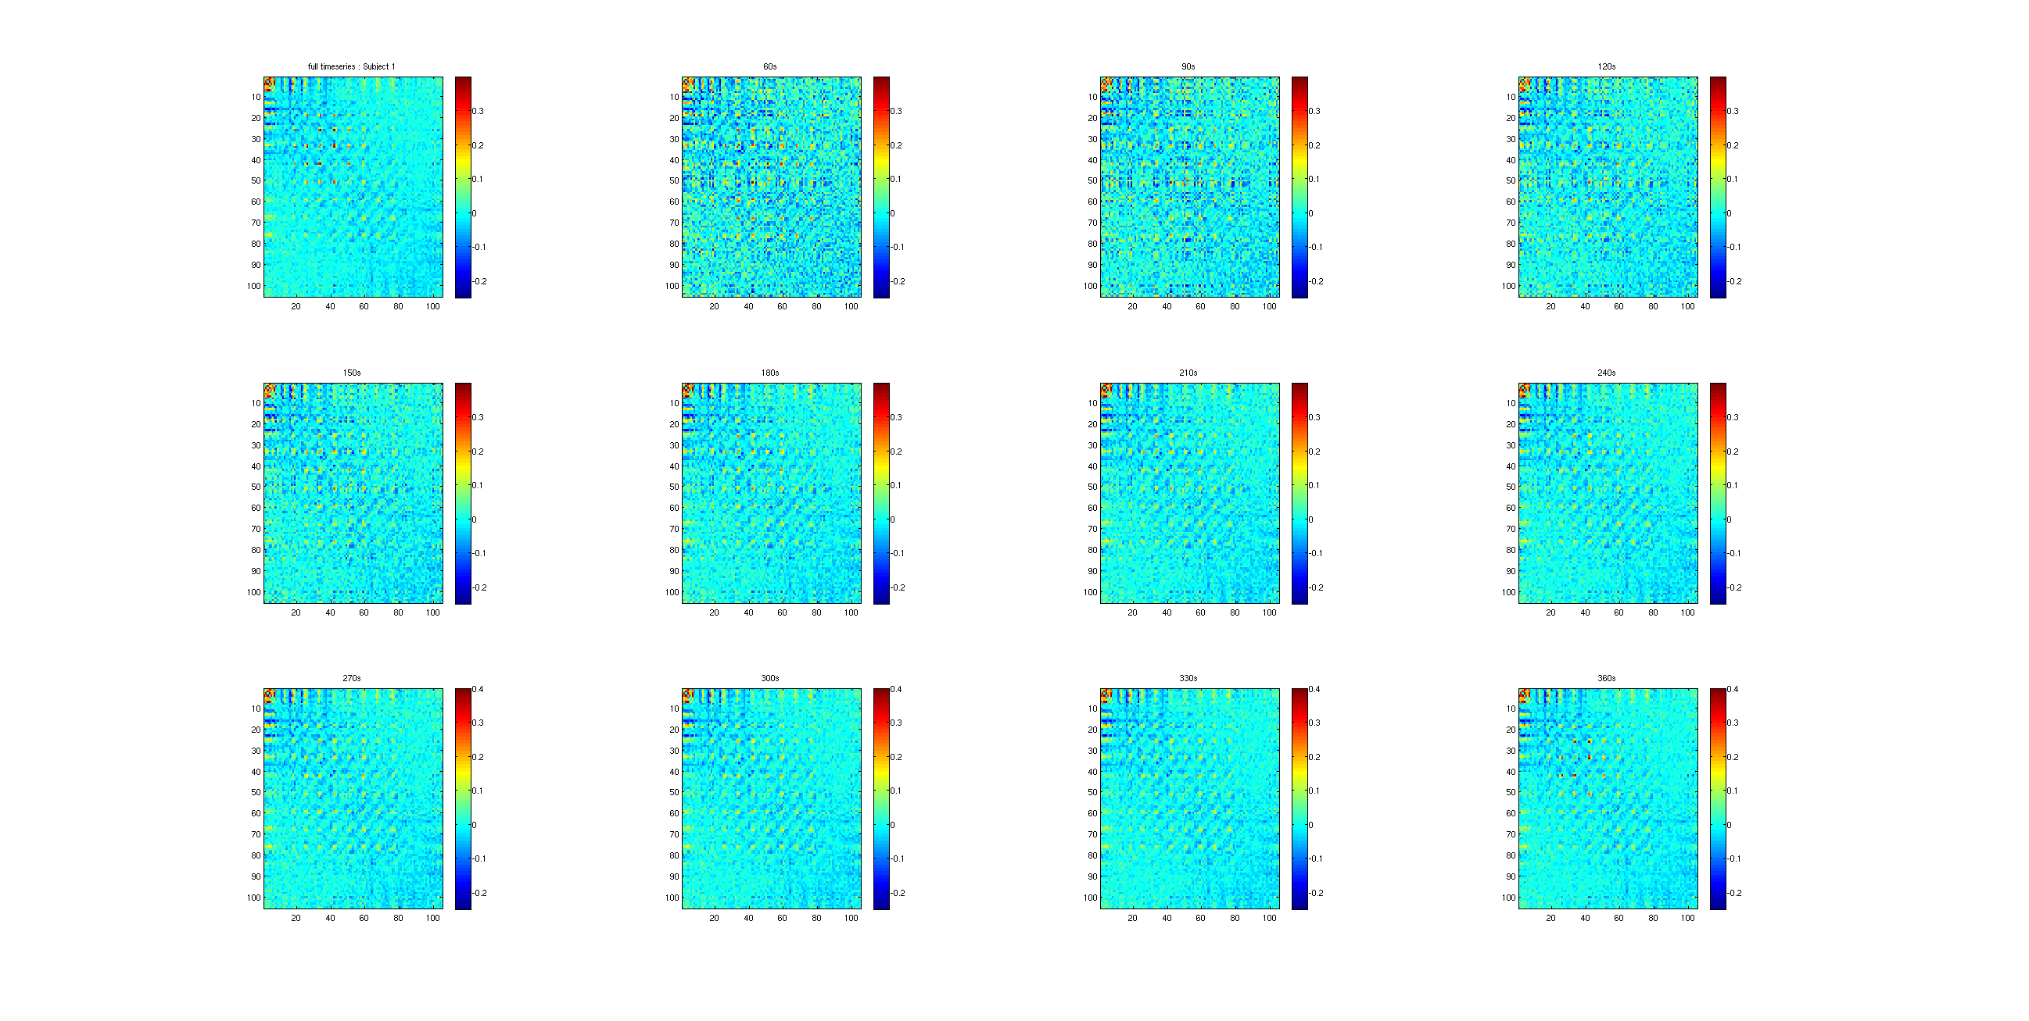
Some subject have missing channels (105):
2, 11, 17, 24, 28 --> For now, discarding these subjects
Connectivity Matrix
Clean data
Subject1
Replicating Figure 2A from Wang 2017 paper

Slide 12
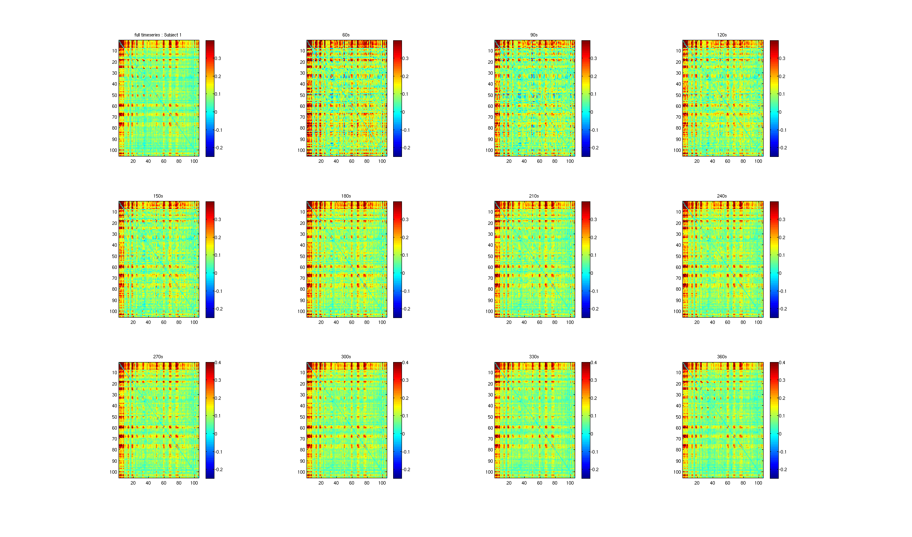
Connectivity Matrix
Subject1
NOT Clean data

Slide 13
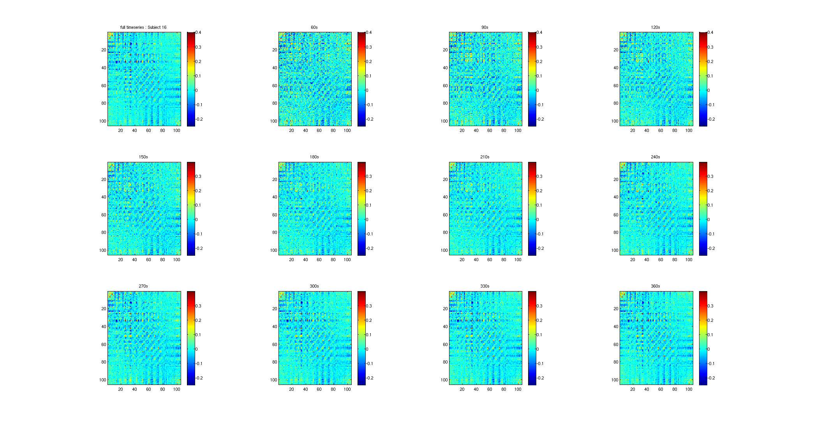
Connectivity Matrix
Clean data
Subject 16

Slide 14
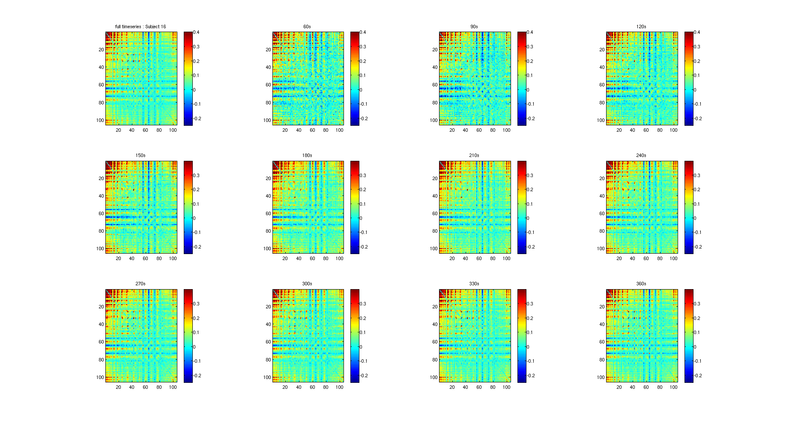
Some subject have missing channels (105):
2, 11, 17, 24, 28 --> For now, discarding these subjects
Connectivity Matrix
NOT Clean data
Subject 16

Slide 15
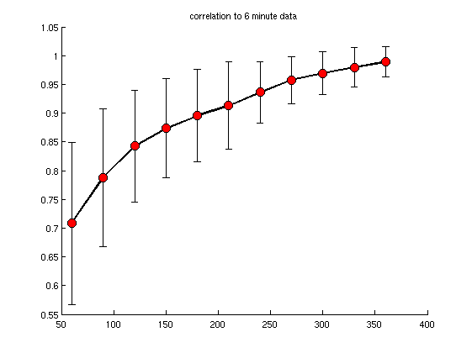
Connectivity Matrix
Replicating Figure 2B from Wang 2017 paper
CLEAN DATA
Oxy
Correlation
Time

Slide 16
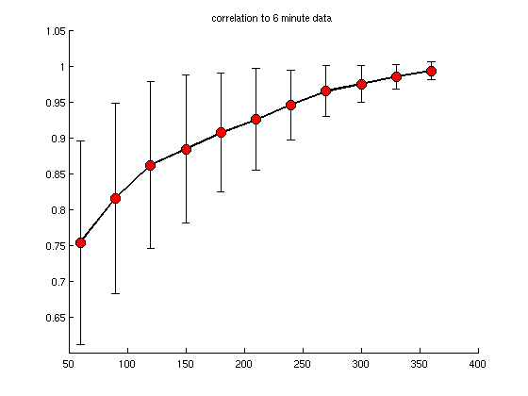
Connectivity Matrix
Replicating Figure 2B from Wang 2017 paper
NOT CLEAN DATA
Oxy
Correlation
Time

Slide 17
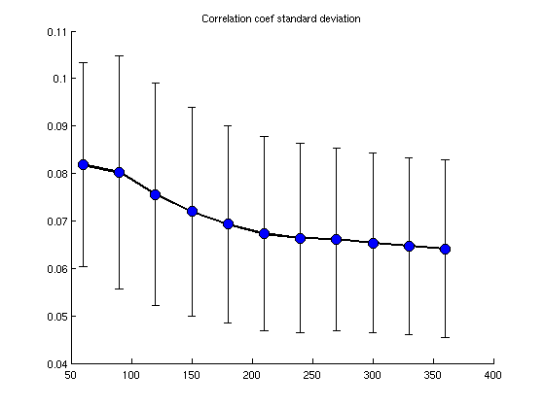
Clean data
Fig 1C
Oxy
Correlation coefficient standard deviation (z-score)

Slide 18
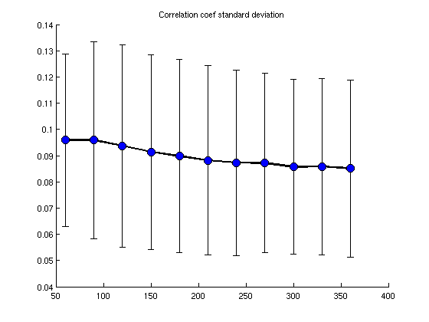
Not Clean data
Fig 1C
Oxy
Correlation coefficient standard deviation

Slide 20
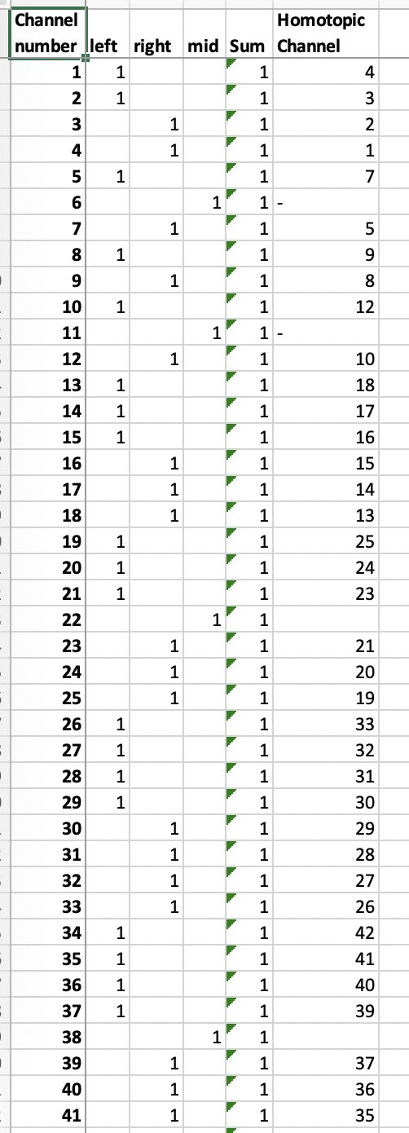
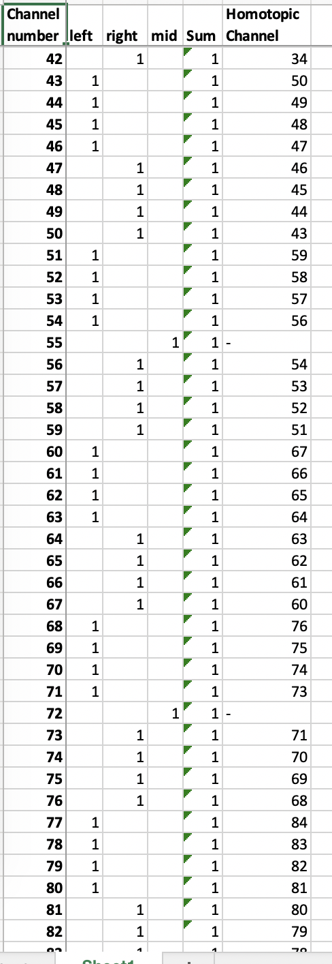
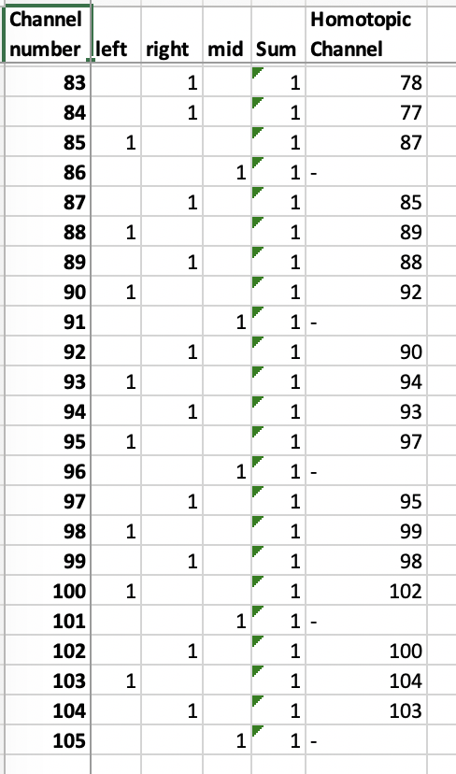
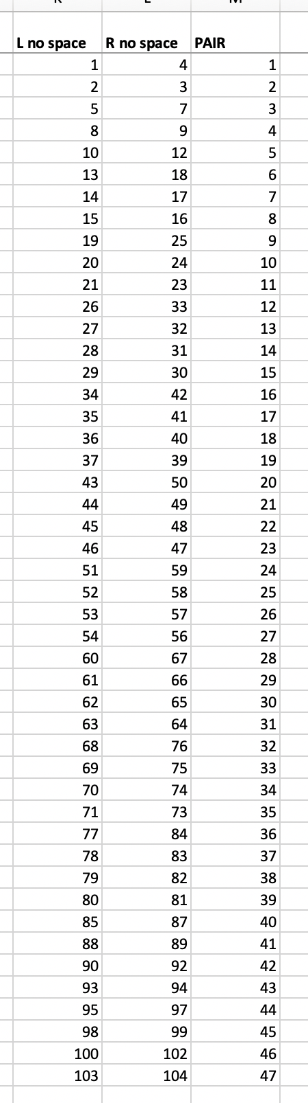
Homotopic
PAIR

Slide 21
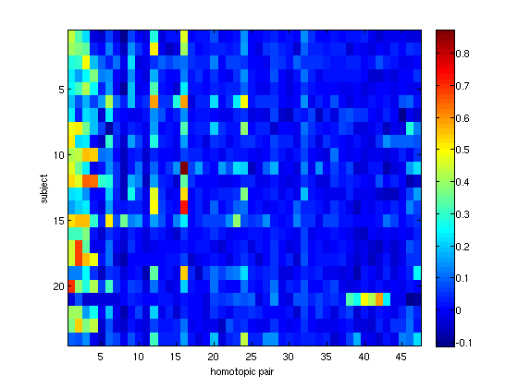
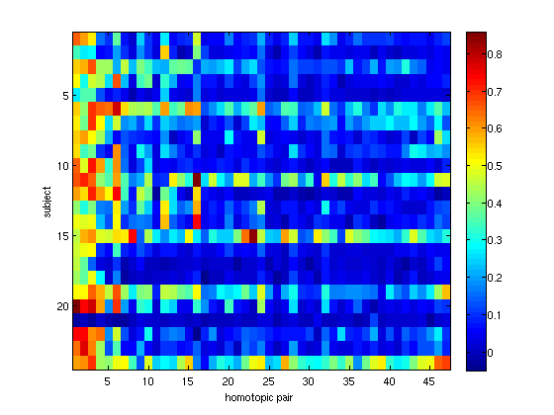
Homotopic
Oxy
105 channels
Clean Data
Not Clean Data
Subject
Homotopic Pair

